Slide 1

Top NBA Teams by Depth
Andrew Edelman

Slide 2
Question At Hand
The team composition for the upcoming 2022-23 season is one of the most balanced in recent years
Without a standout “superteam”, identifying the likely top teams can be difficult, splitting hairs among superstars and their supporting players
Central question: how can we objectively quantify teams we expect to be the best for the upcoming season?

Slide 3

Objective
Identify the top teams in the NBA by using team depth as a measure of how “good” a team is expected to be

Slide 4

Defining: Team Depth
Depth is a term used for many major sports leagues, and often refers to the number of “good” players on a team, particularly further down the roster
NBA teams start 5 players per game, and usually play ~8-10 players in a regular season game; teams with good depth will have good players not only in the starting 5, but going in to the 6-8 spots as well
While depth is not an end-all-be-all for predicting wins, it is often used as a discussion point for how good a team is

Slide 5
Method: Cluster Analysis to Quantify Depth
This analysis uses clustering - categorizing players in to groups based on a variety of game stats that might indicate how good they are
Players were then assigned a “depth value” based on the cluster they were assigned to (i.e. the “better” clusters of good players were assigned higher scores)
Scores were then aggregated at the team level to identify a team “depth score”, and then ranked to identify top teams

Slide 6

1. Get the data
Player data comes from basketball-reference.com
Data was taken from each player’s most recent season
Caveats:
Players who did not play the most recent full season in 2021-22 had their stats taken from their most recent season played

Slide 7
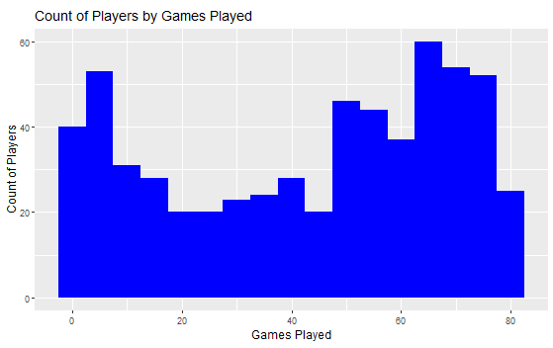
2. Keeping Relevant Players
In the NBA many players only come in to fill spots for a few games, and are not regular season-long players
Players with <15 games in the previous season were removed
***Unless that player started 5+ games, meaning it was a good player who got injured, and is expected to be a regular player in the upcoming year

Slide 8

3. Rookies
Rookies needed to be accounted for in some way, since many rookies can have a significant impact, but rookies do not have any previous seasons’ stats to utilize
Rookie data was taken from each rookie’s “pro comparison” during that player’s rookie year (i.e. the player experts think that rookie will be most similar to)
bleacherreport.com provides this analysis, data taken from basketball-reference.com

Slide 9

4. Clustering
Two methods of clustering (grouping players by statistical performance) were used: hierarchical and k-means
The first round of clustering used season average Points, Rebounds, and Assists from basketball-reference.com
These stats were used in the first pass as they are the most commonly referenced basic statistics

Slide 10
4. Clustering
Players were clustered in to five groups, which was qualitatively decided. Using my experience as a fan, players can generally be thought of as falling in to five categories (the more players you have in the “better” categories, the better your depth)
Superstars – the best players in the league (Giannis, Steph, etc.)
All Stars – great players but not THE best (Donovan Mitchell, Brad Beal, etc.)
Sub-All Stars – important players, but not going to win any awards (OG Anunoby, Malcolm Brogdon)
Rotation Players – non-starting players, but who receive regular minutes (Cedi Osman, George Hill)
Garbage Time Players – players regularly enough on the roster to take in to account, but usually only play when a game has been decided

Slide 11
4. Clustering: Results
***Note: cluster group is randomly assigned and is not in any order indicating how good that group of players is
Hierarchical Clustering Group | Number of Players | Avg Points | Avg Assists | Avg Rebounds
1 | 362 | 7.6 | 1.4 | 3.3
2 | 41 | 15.9 | 2.8 | 9.1
3 | 6 | 29.4 | 6.5 | 10.3
4 | 73 | 16.7 | 5. | 4.3
5 | 4 | 21.6 | 10.0 | 6.0
K-Means Clustering Group | Number of Players | Avg Points | Avg Assists | Avg Rebounds
1 | 36 | 15.0 | 2.6 | 9.5
2 | 175 | 4.8 | 1.1 | 2.1
3 | 49 | 21.9 | 6.4 | 5.9
4 | 91 | 13.6 | 3.3 | 3.7
5 | 135 | 8.7 | 1.3 | 4.6

Slide 12
4. Clustering: Takeaways
These clusters do not get us what we’re looking for as it doesn’t take in to account type/position of player
While high points, rebounds, and assists generally indicate a good player, different player types will have different stat make ups, and thus equally “good” players will be clustered differently
For example, good “big” players will usually have high points, higher rebounds, and lower assists; whereas smaller players will have high points, but lower rebounds and higher assists
See differences in clusters 3 and 5 for hierarchical, and 1 and 3 for k-means

Slide 13

Step 5. Pivoting Approach
To correct for this, we can look in to using advanced game stats as opposed to standard points, rebounds, and assists
We’ll run the cluster analysis again using Win Share (WS) and Value over Replacement Player (VORP) – more generalized stats for winning and relational player value, available from basketball-reference.com
This should correct for player type/position issue, and give us a more generalized view of how good players are

Slide 14

Step 6. Re-clustering
The data cleaning and clustering methods used here are exactly the same as before, only difference is using WS and VORP to cluster instead of points, rebounds, and assists
The number of clusters was also kept the same, based on previous logic

Slide 15
Step 6. Re-clustering: Results
***Note: cluster group is randomly assigned and is not in any order indicating how good that group of players is
Hierarchical Cluster Group | Number of Players | Avg WS | Avg VORP
1 | 194 | 2.4 | 0.4
2 | 85 | 5.4 | 1.6
3 | 32 | 8.1 | 3.7
4 | 172 | 0.5 | -0.2
5 | 3 | 13.4 | 7.9
K-Means Cluster Group | Number of Players | Avg WS | Avg VORP
1 | 145 | 2.5 | 0.4
2 | 16 | 9.8 | 5.1
3 | 79 | 4.8 | 1.3
4 | 205 | 0.6 | -0.2
5 | 41 | 7.1 | 2.6

Slide 16

Step 6. Re-Clustering: Takeaways
These results give us a better trend between the two variables WS and VORP (i.e. they appear more directly correlated)
These groupings are more likely to be indicative of general “goodness” of a player
i.e. group 5 of hierarchical and 2 of k-means would indicate the best players, as they have the highest WS and VORP

Slide 17
7. Assigning Player Value
Each player is assigned a “player value” based on their cluster, which will in turn be summed at the team level to calculate depth. These values were assigned qualitatively, and roughly in line with average WS for each cluster (higher values for better WS/VORP average).
Hierarchical Cluster Group | Player Value Assigned | K-Means Group | Player Value Assigned
1 | 3 | 1 | 3
2 | 5 | 2 | 10
3 | 10 | 3 | 5
4 | 1 | 4 | 1
5 | 15 | 5 | 7

Slide 18

8. Calculating Team Depth
Player values were then summed up at the team level to achieve a team “depth value”
Based on the team players are starting on for the current 2022-23 season
Depth values were cut off after the top 9 players for each team, to limit it to players seeing the most playing time, as well as to ensure teams are being compared with equal player amounts

Slide 19
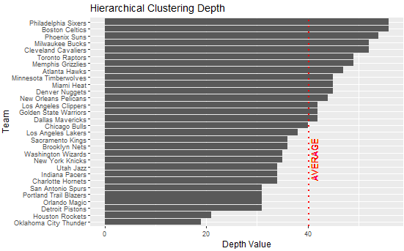
8. Calculating Team Depth

Slide 20
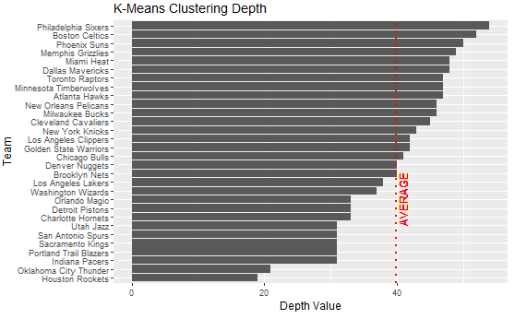
8. Calculating Team Depth

Slide 21

9. Model Accuracy
Before finalizing team ranks, we’ll identify the more accurate of the two models to use
First, the teams were ranked 1-30 for each method, based on the previous charts
The rankings were then compared to the official nba.com power rankings
These are the NBA’s official team rankings, which we’ll assume are the gold standard, and the target of accuracy for these models

Slide 22
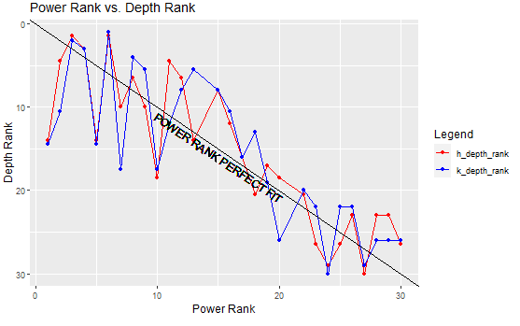
9. Model Accuracy
We can see the depth rank developed from these models varies from the power rankings, particularly at the top
However, the model did identify the general trend of good to bad teams along side the power rankings

Slide 23
9. Model Accuracy
To determine the more accurate model, use the average difference between the models’ rank, and NBA power rank, for each team (ex. if the model ranked a team 2, and their power rank is 5, the different is 3 – averaged for each team)
Average difference for the Hierarchical Model: 3.875
i.e. we’d expect the average team in this ranking to be within 3.875 rank positions of the official power rank
Average difference for K-Means Mode: 4.571

Slide 24





10. Results
Top 5 Teams based on hierarchical clustering:
Boston Celtics
Philadelphia Sixers
Phoenix Suns
Cleveland Cavaliers
Milwaukee Bucks
Four of these five teams fall in the NBA power ranking top 6, so in generally the model agrees that Boston, Philly, Phoenix, and Milwaukee will be good this season

Slide 25

10. Results
The model did identify Cleveland as a top 5 team, although the power rankings have them as 11.
Having grown up in Cleveland, my unbiased opinion is that this is correct.
Takeaway: Cleveland is a deep, and possibly underrated team going in to this season
Where the model missed: Golden State Warriors
Both models ranked GSW around 14, when they are the favorite to win the championship this year. Further analysis would need to be done to look in to why GSW was ranked so low in terms of depth.

Slide 26

11. Considerations: Data Caveats
One big caveat here is that we’re using historical data, which bring in a few issues:
Rookie projections are notoriously difficult, and pro comparisons will almost certainly not be accurate
Players coming off injury/general aging are likely to do worse than previous seasons
Players entering their prime are likely to do better than previous seasons

Slide 27
11. Considerations: Tweaking the Clusters
Qualitative decisions described earlier were made to determine the number of clusters, assigning player value based on cluster, etc.
Given that we saw some inaccuracies (i.e. Golden State) in the model rankings, it would be worth looking in to some specific player values, and re-running this trying some variation in number of clusters or player value points
There are also a variety of other advanced metrics available on basketball-reference.com which can be brought in

